Slide 1

Introduction to OpenNMS SouthEast LinuxFest – 13 June 2010
Tarus Balog
tarus@opennms.org

Slide 2
Agenda
What the heck is OpenNMS?
Getting It Installed
Discovery
Event Management
Service Assurance
Data Collection

Slide 3
OpenNMS is the world's first enterprise-grade network management application platform developed under the open source model.

Slide 4


“world's first”
NetSaint 2000-01-10 1323
OpenNMS 2000-03-29 4141
Nagios 2001-05-03 26589
RRDTool 2003-01-13 71544
Groundwork 2006-02-21 160654
ZenOSS 2006-03-20 163126
Hyperic 2006-07-17 172556

Slide 5
“enterprise-grade”
Nearly 60,000 Devices on a Single Instance (Swisscom)
1.2 Million Data Points Every Five Minutes (New Edge)
32,000 Interfaces per Device (Wind)
3000 Remote Monitors (Papa Johns)

Slide 6
“network management application platform”
The Architecture of OpenNMS has been designed to allow for easy integration of other tools, both proprietary and open.

Slide 7
“open source model”
OpenNMS is published under the GPL and all components are licensed under an OSI-qualified free software license.

Slide 8
The Four Main Areas of OpenNMS
Provisioning: Both Automated Discovery and Directed Discovery.
Event and Notification Management: Generate, receive, reduce and correlate various network alerts and feed them to a robust notification system.
Service Assurance: Is a particular network service reachable and available?
Performance Data Collection: Gather numeric data from across the network for display, trending and thresholding.

Slide 9
Let's Get This Sucker Installed
Java JDK (1.5 or higher)
PostgreSQL
jicmp
opennms-core
An opennms webapp
iplike
jrrd (optional)

Slide 10
Packages Are Your Friend
Use “yum” on rpm-based distros
Use “apt” on Debian/Ubuntu distros
Use “fink” on Mac OS X
Use Solaris packages for Sun
Use the standalone installer for Windows
Use the wiki for FreeBSD

Slide 11
Where OpenNMS Stores Data
Database (PostgreSQL)
Round Robin Database (JRobin or RRDtool)
Configuration: $OPENNMS_HOME/etc Usually in XML files

Slide 12
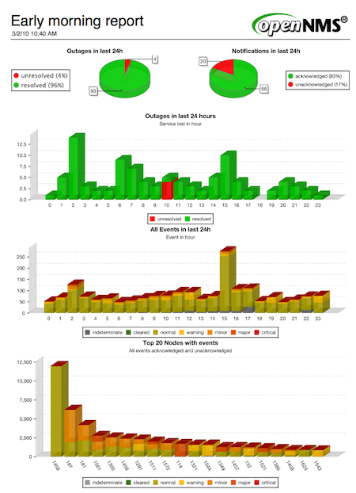

Slide 13
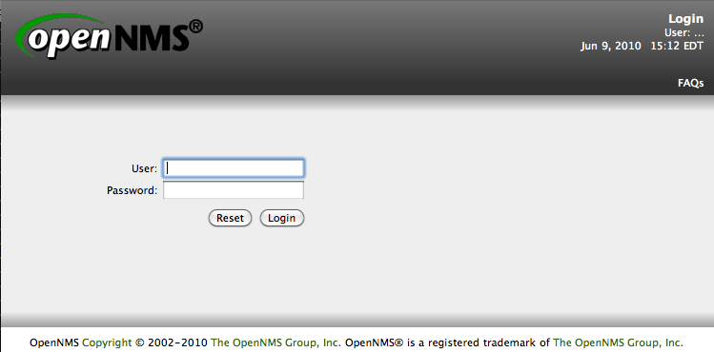

Slide 14
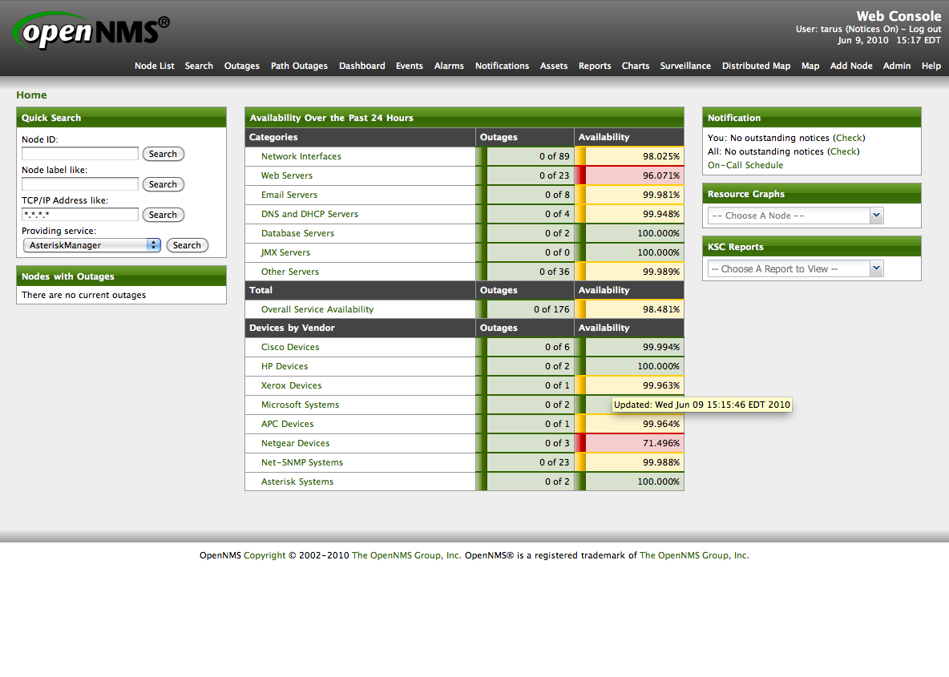

Slide 15
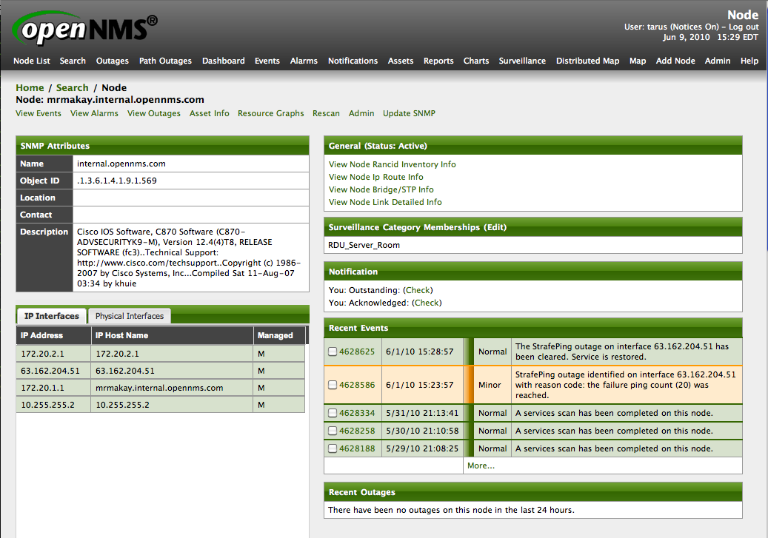

Slide 16
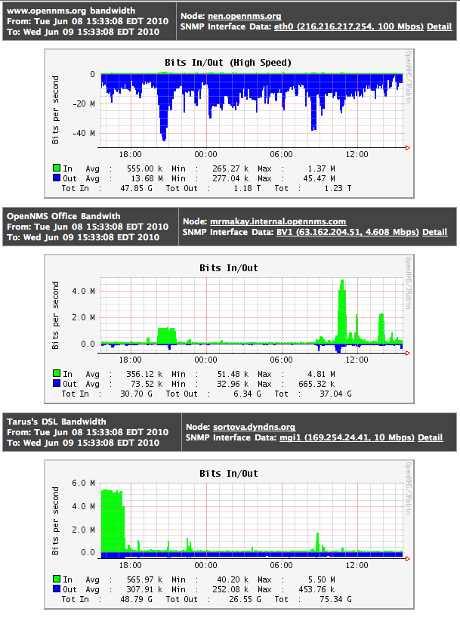

Slide 17
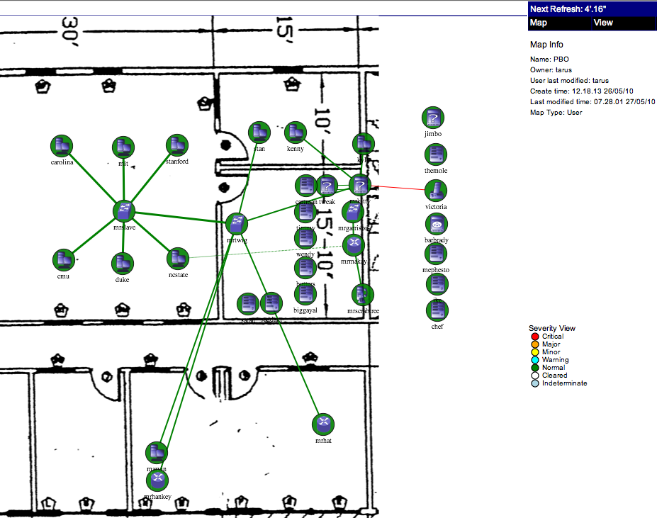

Slide 18
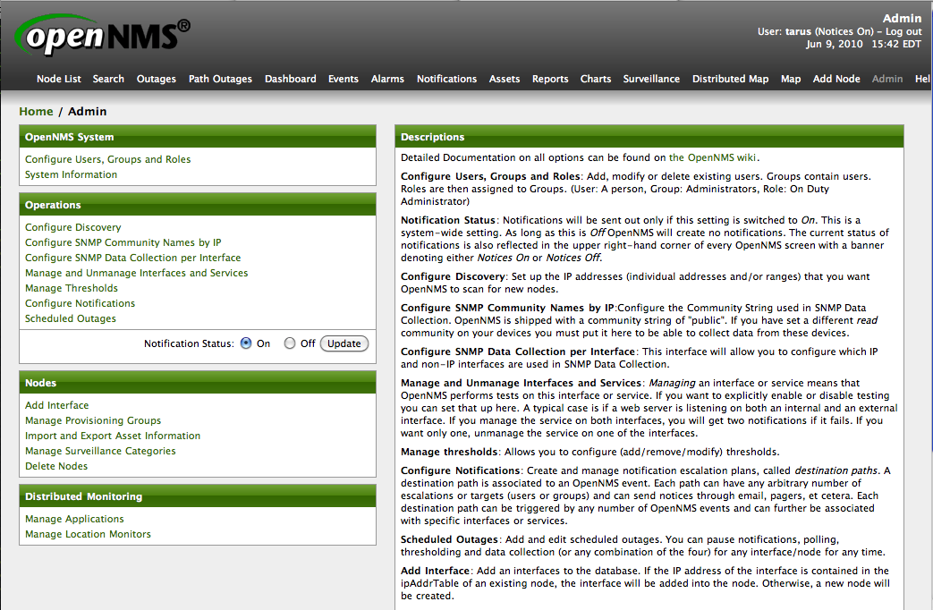

Slide 19
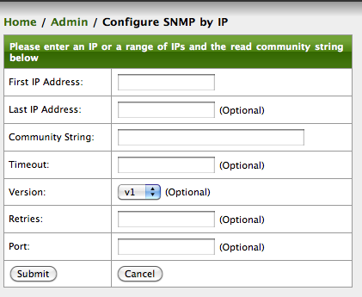

Slide 20
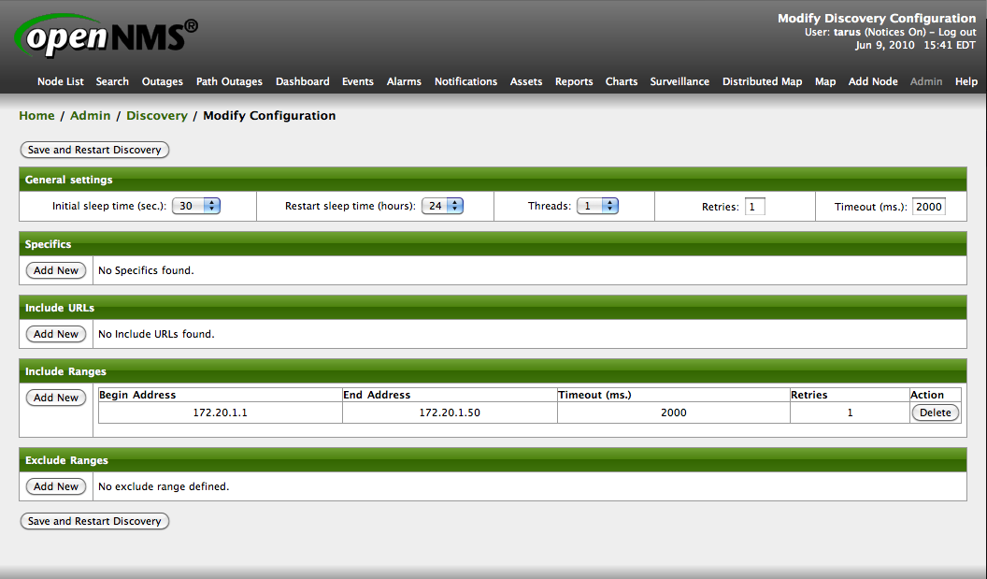

Slide 21
<discovery-configuration
threads="1"
packets-per-second="1"
initial-sleep-time="30000"
restart-sleep-time="86400000"
retries="1"
timeout="2000">
<include-range retries="1" timeout="2000">
<begin xmlns="">172.20.1.1</begin>
<end xmlns="">172.20.1.50</end>
</include-range>
</discovery-configuration>

Slide 22
provisiond
Controls both automated and directed discovery
The “foreign source” controls what gets discovered
The “foreignid” is a unique key for the device
Can finely control what gets discovered
Everything reflected in XML files

Slide 23
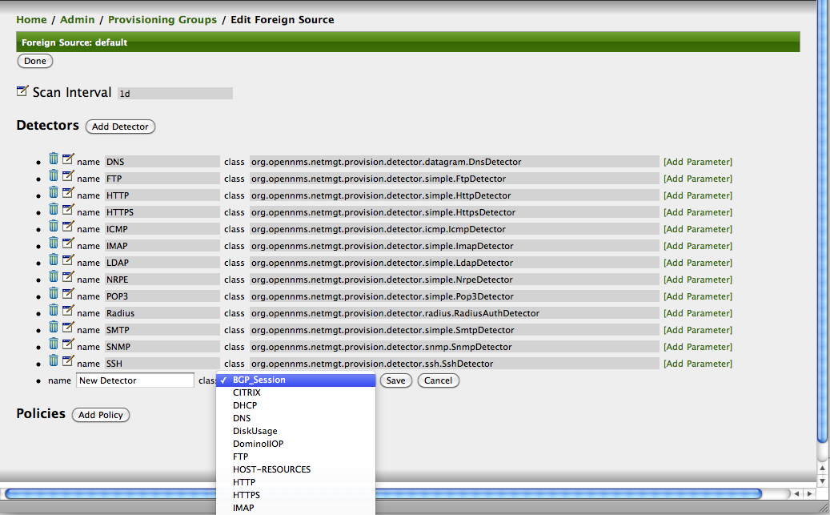
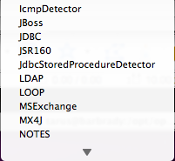

Slide 24
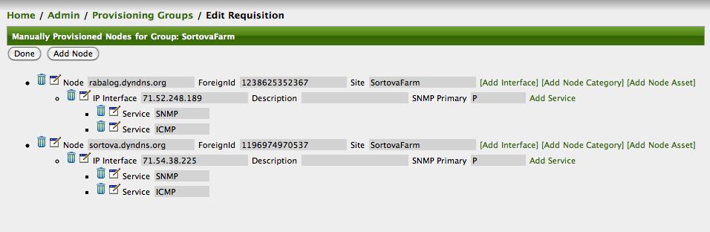

Slide 25
<model-import
last-import="2010-06-08T08:49:35.190-04:00"
foreign-source="SortovaFarm"
date-stamp="2010-06-08T08:49:34.616-04:00">
<node node-label="rabalog.dyndns.org"
foreign-id="1238625352367" building="SortovaFarm">
<interface status="1" snmp-primary="P"
ip-addr="71.52.248.189" descr="">
<monitored-service service-name="SNMP"/>
<monitored-service service-name="ICMP"/>
</interface>
</node>
<node node-label="sortova.dyndns.org"
foreign-id="1196974970537" building="SortovaFarm">
<interface status="1" snmp-primary="P"
ip-addr="71.54.38.225" descr="">
<monitored-service service-name="SNMP"/>
<monitored-service service-name="ICMP"/>
</interface>
</node>
</model-import>

Slide 26
Events
OpenNMS can generate internal events, receive external events such as SNMP traps
Events can be reduced – taking a number of events and representing them as a single line with a count
Events can be translated into other events
There are a variety of correlation methods to match problems with resolutions, identify widespread outages and “flapping”

Slide 27
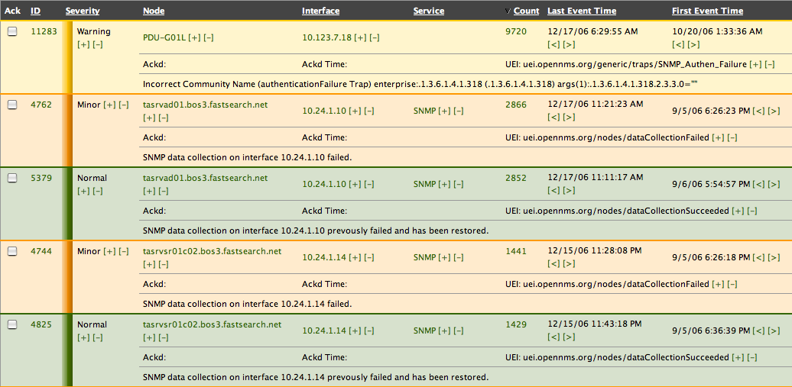
Event reduction

Slide 28
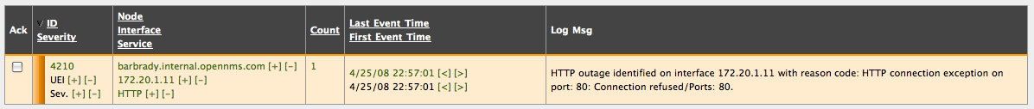
Automations

Slide 29
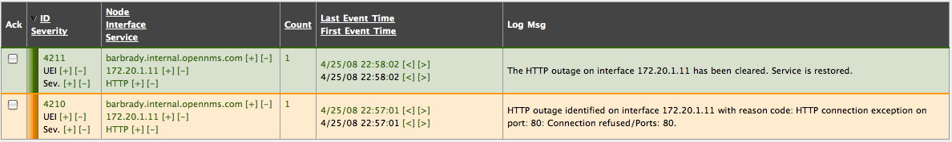
Automations

Slide 30
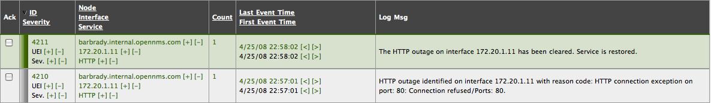
Automations

Slide 31
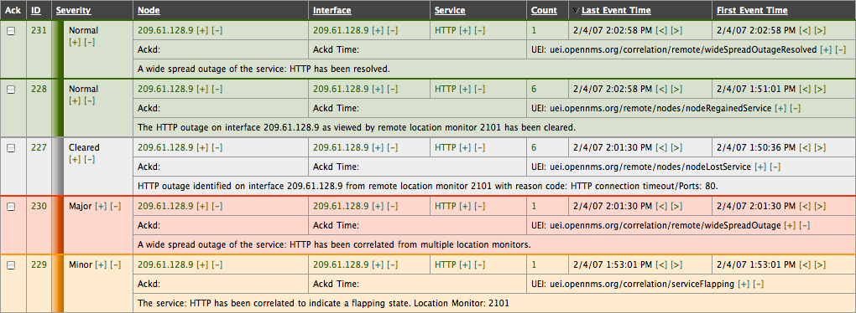
Correlation

Slide 32
Create Custom Events
OpenNMS listens on port 5817 for event messages
Events are simply properly formatted XML objects
Use or modify the included send-event.pl script for creating events

Slide 33
Unique Event Identifier
A new interface is discovered: uei.opennms.org/internal/discovery/newSuspect
A service is down: uei.opennms.org/nodes/nodeLostService
All services on an interface are down: uei.opennms.org/nodes/interfaceDown
All interfaces on a node are down:
uei.opennms.org/nodes/nodeDown

Slide 34
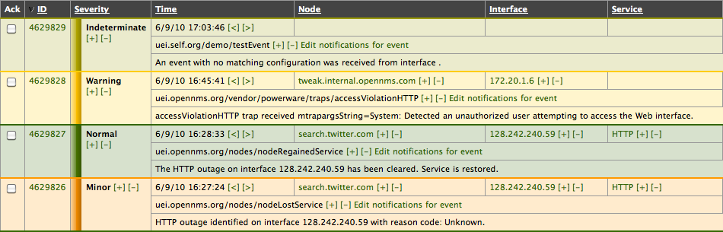
Create Custom UEIs
$ send-event.pl uei.self.org/demo/testEvent

Slide 35
Configure the UEI
$ cat SELF.events.xml
<events>
<event>
<uei>uei.self.org/demo/testEvent</uei>
<event-label>An Event Created for the SELF Conference</event-label>
<descr>&lt;p&gt;
This event is just to demonstrate custom events in OpenNMS.
&lt;/p&gt;
</descr>
<logmsg dest='logndisplay'>
&lt;p&gt;
Hello folks at SELF.
&lt;/p&gt;
</logmsg>
<severity>Warning</severity>
</event>
</events>

Slide 36
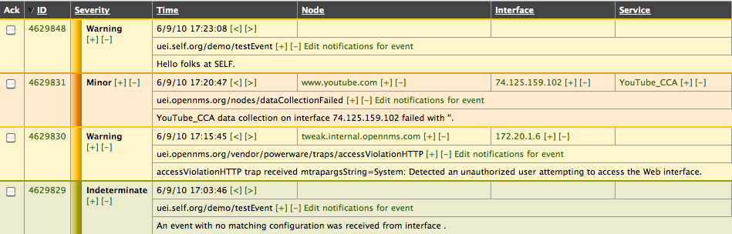
Create Custom UEIs
$ send-event.pl uei.self.org/demo/testEvent

Slide 37
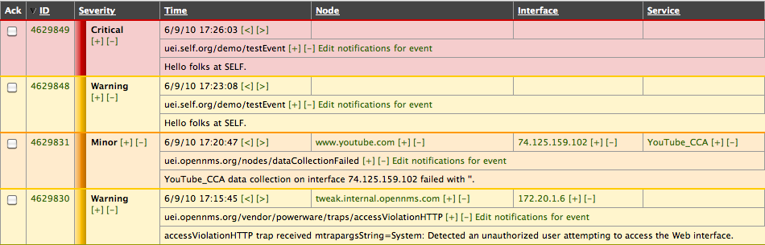
Create Custom UEIs
$ send-event.pl –severity 7 uei.self.org/demo/testEvent

Slide 38
Notifications
Any command line application can be used to send notices:
Email
Pages
SMS messages
IM's via XMPP (Jabber)
Includes
Duty schedules and roles
Escalations
Auto acknowledgment

Slide 39
Service Assurance
Monitor network services like HTTP, DNS, Databases and even ICMP
Calculate availability over devices and categories.
Packages and adaptable downtime models
Support for plugins, including Nagios® and custom scripts
Distributed monitoring via webstart app

Slide 40
Adaptable Downtime Model
When an outage occurs, OpenNMS changes the default service poll:
30 second polls for the first 5 minutes
5 minute polls for the first 12 hours
10 minute polls for the first 5 days
Unmange the service if down longer
Shortest outage is on the order of 30 seconds

Slide 41
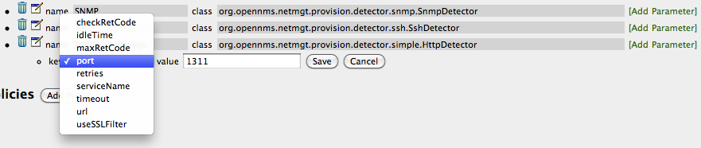
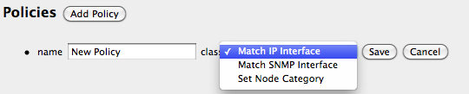

Slide 42
Using Net-SNMP for SA
Protocols like SSH don't scale and have security issues
Net-SNMP can be easily extended and secured
Use the “extend” feature with OpenNMS for easy custom poller creation

Slide 43
$ mailq
-Queue ID- --Size-- ----Arrival Time---- -Sender/Recipient-------
2BCEFAC8DE 6907 Mon Jun 7 23:55:02 MAILER-DAEMON
(connect to wanadoo.co.uk[195.92.249.131]:25: Connection timed out)
watsonians@example.co.uk
CC185AC83D 1026 Tue Jun 8 21:21:12 jay@opennms.com
(connect to jdsubmit.yahoo.com[98.137.132.14]:25: Connection timed out)
micheal.marnell@example.com
-- 9 Kbytes in 2 Requests.
$ cat ./mailqstats.sh
#!/bin/bash
ISZERO=`mailq | grep Mail\ queue\ is\ empty | wc -l`
if [ $ISZERO -eq 1 ] ; then
echo 0
exit 0
fi
mailq | grep Request | awk '{print $5}'
$ ./mailqstats.sh
2

Slide 44
In /etc/snmp/snmpd.conf:
extend mailqstats /root/crons/mailqstats.sh
$ snmpwalk -v1 -c public 10.1.1.1 .1.3.6.1.4.1.8072.1.3.2
NET-SNMP-EXTEND-MIB::nsExtendNumEntries.0 = INTEGER: 1
NET-SNMP-EXTEND-MIB::nsExtendCommand."mailqstats" = STRING: /root/crons/mailqstats.sh
NET-SNMP-EXTEND-MIB::nsExtendArgs."mailqstats" = STRING:
NET-SNMP-EXTEND-MIB::nsExtendInput."mailqstats" = STRING:
NET-SNMP-EXTEND-MIB::nsExtendCacheTime."mailqstats" = INTEGER: 5
NET-SNMP-EXTEND-MIB::nsExtendExecType."mailqstats" = INTEGER: exec(1)
NET-SNMP-EXTEND-MIB::nsExtendRunType."mailqstats" = INTEGER: run-on-read(1)
NET-SNMP-EXTEND-MIB::nsExtendStorage."mailqstats" = INTEGER: permanent(4)
NET-SNMP-EXTEND-MIB::nsExtendStatus."mailqstats" = INTEGER: active(1)
NET-SNMP-EXTEND-MIB::nsExtendOutput1Line."mailqstats" = STRING: 2
NET-SNMP-EXTEND-MIB::nsExtendOutputFull."mailqstats" = STRING: 2
NET-SNMP-EXTEND-MIB::nsExtendOutNumLines."mailqstats" = INTEGER: 1
NET-SNMP-EXTEND-MIB::nsExtendResult."mailqstats" = INTEGER: 0
NET-SNMP-EXTEND-MIB::nsExtendOutLine."mailqstats".1 = STRING: 2
.1.3.6.1.4.1.8072.1.3.2.4.1.2.10.109.97.105.108.113.115.116.97.116.115.1 = STRING: 2

Slide 45
In poller-configuration.xml:
<service name="Mailq" interval="300000"
user-defined="false" status="on">
<parameter key="retry" value="1"/>
<parameter key="timeout" value="3000"/>
<parameter key="port" value="161"/>
<parameter key="oid"
value=".1.3.6.1.4.1.8072.1.3.2.4.1.2.10.109.97.105.108.113.115.116.97.116.115.1"/>
<parameter key="operator" value="&lt;"/>
<parameter key="operand" value="300"/>
</service>
<monitor service="Mailq" class-name="org.opennms.netmgt.poller.monitors.SnmpMonitor"/>

Slide 46
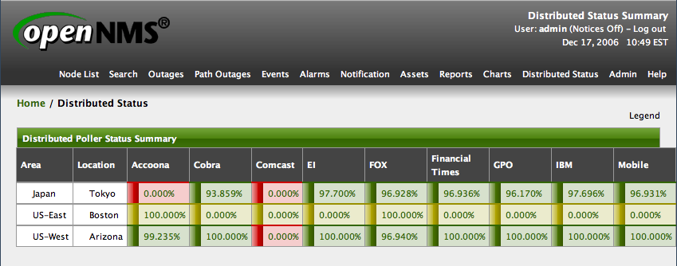
Distributed Monitoring

Slide 47
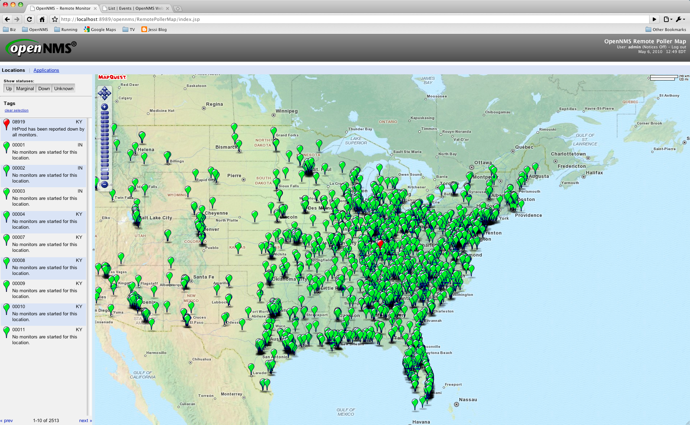
Maps Integration

Slide 48
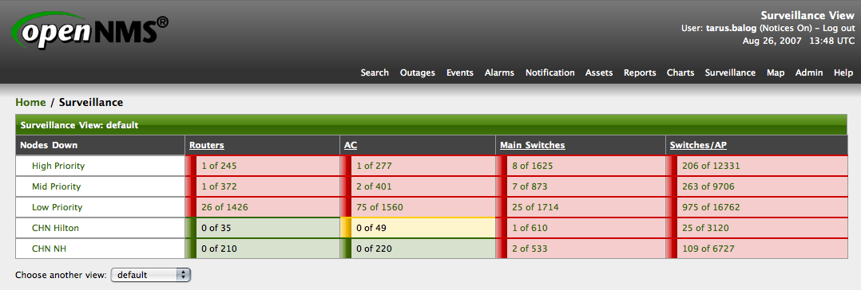
Surveillance Views

Slide 49
Performance Data Collection
Uses JRobin (or RRDTool) to store time series data
Support for
SNMP (v1, v2c, v3)
JMX
HTTP
NSClient
WMI
Automated configuration

Slide 50
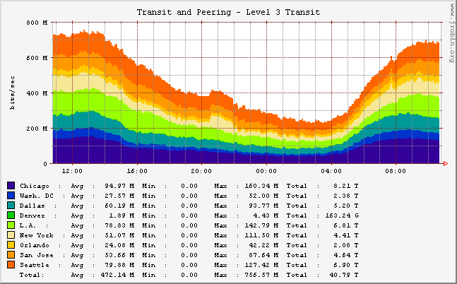
Performance reports

Slide 51
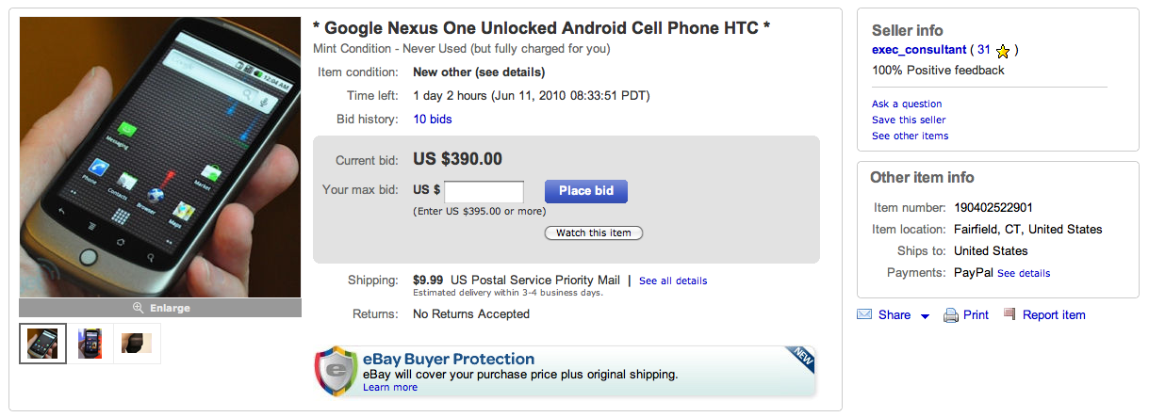
Tracking an eBay Auction

Slide 52
Figure Out the RegEx
<td colspan="4" height="10"></td></tr><tr><td colspan="4"
class="vi-is1-bdr"><div class="vi-is1-tl"><div class="vi-is1-tr"></div></div></td></tr><tr>
<td class="vi-is1-lblp vi-is1-solidBg">Current bid:</td>
<td class="vi-is1-solid vi-is1-tbll"><span>
<span id="v4-32" class="vi-is1-prcp">US $390.00</span></span></td>
(?s).*?Current bid.*?US.*?([.0-9]+).*

Slide 53
Discovery and Collection
In collectd-configuration.xml:
<package name="ebay">
<filter>IPADDR != '0.0.0.0'</filter>
<include-range begin="1.1.1.1" end="254.254.254.254"/>
<service name="EbayAuction" interval="300000"
user-defined="false" status="on">
<parameter key="collection" value="ebay"/>
<parameter key="retry" value="1"/>
<parameter key="timeout" value="7000"/>
</service>
</package>
<collector service="EbayAuction"
class-name="org.opennms.netmgt.collectd.HttpCollector"/>

Slide 54
Define HTTP Collection
In http-datacollection-config.xml:
<uris>
<uri name="ebay">
<url path="/ws/eBayISAPI.dll?ViewItem&amp;item=190402522901"
virtual-host="cgi.ebay.com"
user-agent="Mozilla/5.0"
matches="(?s).*?Current bid.*?US.*?([.0-9]+).*"
response-range="100-399" >
</url>
<attributes>
<attrib alias="ebayprice" match-group="1" type="gauge32"/>
</attributes>
</uri>
$ ls -l /opt/opennms/share/rrd/snmp/121
total 288
-rw-rw-r-- 1 root root 282736 Jun 10 11:07 ebayprice.jrb

Slide 55
Create the Graph
In snmp-graph.properties:
report.example.ebay.name=This an Ebay Auction
report.example.ebay.columns=ebayprice
report.example.ebay.type=nodeSnmp
report.example.ebay.command= \
--title="The price of a Nexus One eBay Auction" \
DEF:number={rrd1}:ebayprice:AVERAGE \
LINE2:number#00A000:"Price" \
GPRINT:number:AVERAGE:" Avg \\: %8.2lf %s" \
GPRINT:number:MIN:"Min \\: %8.2lf %s" \
GPRINT:number:MAX:"Max \\: %8.2lf %s\\n"

Slide 56
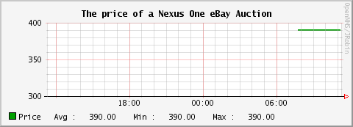
eBay Auction Graph

Slide 57
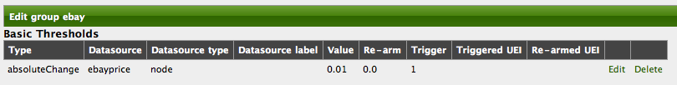
Configure Thresholds

Slide 58
Severe Weather
Severe Weather

Slide 59
The OpenNMS Project
The Wiki: http://www.opennms.org/wiki/Mailing_lists
The Mailing Lists
opennms-install
opennms-discuss
opennms-devel
opennms-announce
IRC: #opennms on freenode.

